Slide 1
Welcome and Introduction Overview of Cryptography Instructor: Kelly Handerhan CISSP, CISM, CCSP, PMP, CRISC, etc.

Slide 2

Welcome and Introduction
Kelly Handerhan, Instructor, Owner CyberTrain.IT
Over twenty years experience in Information Assurance, and Cybersecurity
Award-winning technical instructor
One of the original instructors for Cybrary.it
Certified in:
CISSP , CCSP, CISM, CRISC, PMP, Security+, Etc.
KELLY HANDERHAN, Instructor, Owner of CyberTrain.IT
KellyH@CyberTrain.IT

Slide 3
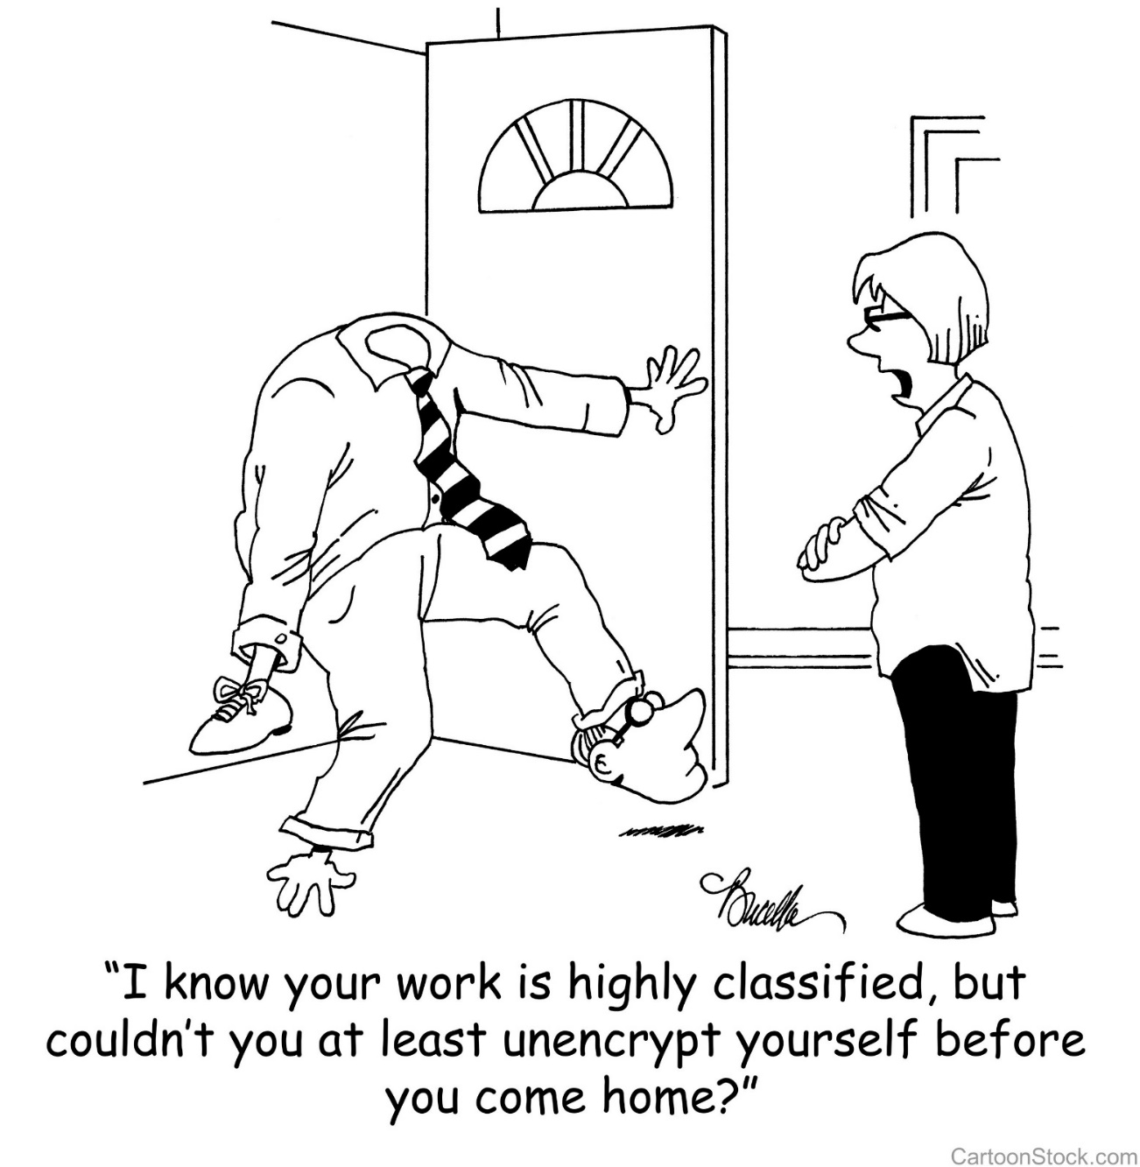
Presentation: An Overview of Cryptography

Slide 4
Module 3 Security Engineering and Architecure Part 1: Cryptography
Cryptography Through History
Cryptography Basics
Symmetric Cryptography
Asymmetric Cryptography
Hybrid Cryptography
Public Key Infrastructure
MACs
IPSec
Email Cryptosystems
Attacks on Cryptography

Slide 5
Cryptography Through History

Slide 6
Cryptography in History
Caesar Cipher
Scytale
Vignere
Vernam
Enigma Machine and Purple Machine

Slide 7
Caesar Cipher
Simple Substitution
Shift Characters 3 spaces
A=D, B=E, C=F, etc
Substitution Ciphers are subject to pattern analysis

Slide 8
Scytale
Spartans used this cipher to communicate messages to generals in the field
Wrapped tape around a rod
Diameter of the rod is the pre-agreed upon secret (key)

Slide 9
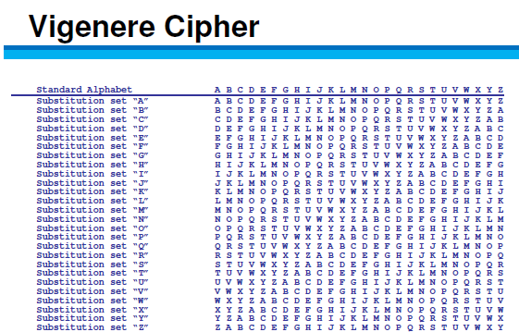
Vignere
First polyalphabetic cipher
Key word is agreed upon ahead of time
First letter of the key is matched up against first letter of the message, and so on

Slide 10
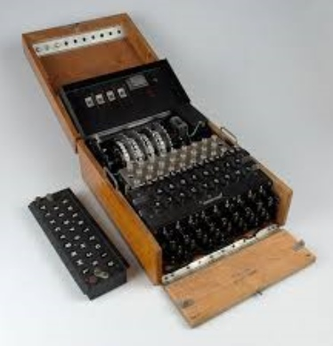
Cryptography in Warfare
Enigma Machine/Purple Machine
Used by the Germans/Japanese in WWII
Breaking the cryptography of these devices is credited with reducing the length of the war.

Slide 11
Vernam Cipher
One Time Pad
Only mathematically unbreakable form of cryptography
Key must be used only once
Pad must be at least as long as the message
Key pad is statistically unpredictable
Key Pad must be delivered and stored securely

Slide 12
Cryptography Basics

Slide 13
Security Services provided by Cryptography
Privacy: Prevents unauthorized disclosure of information
Authenticity: Verifies the claimed identity
Integrity: Detects modification or corruption
Non-Repudiation: Combines authenticity and integrity. A sender can’t dispute having sent a message, nor its contents.

Slide 14
Definitions and Concepts
Plain Text + Initialization Vector + Algorithm (aka Cipher) + Key
=
Cipher Text

Slide 15
Initialization Vector
Here are some random numbers (I promise, they’re really random!)
7 5 2 3 4 9 4
If we start at track 0 and +7 +5 – 2 +3 + 4 +9 -4
We still don’t have randomness. Vary the starting point and that will make the process more random
Very similar to a “seed” or a “salt”

Slide 16
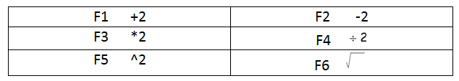
Algorithm

Slide 17
Elements of Cryptography
Desirable Qualities of an Algorithm
Confusion
Diffusion
Chaining
Permutations
Open—Kerchoff's Principle
Desirable Qualities of a Key
Long
Random
Secret

Slide 18
Definitions and Concepts
Plain text is unencrypted text
Initialization Vector (IV) adds randomness to the beginning of the process
Algorithm is the collection of math functions that can be performed
Key: Instruction set on how to use the algorithm

Slide 19
Symmetric Cryptography

Slide 20
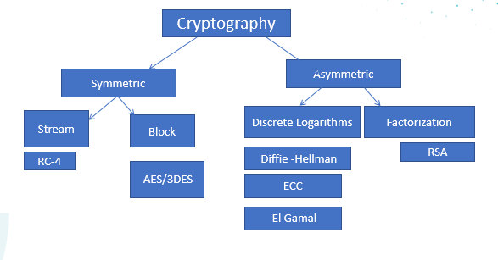
Cryptography

Slide 21
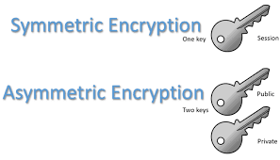
Cryptography Overview
Symmetric Cryptography
Pros
Provides FAST data transfer
Good strong privacy
Cons
Out of band key distribution
Doesn’t scale well
Doesn’t provide non-repudiation
Can be called “Secret,” “Private,” “Shared,” or “Session” Key
A single key is shared by both parties and is used to encrypt and decrypt
Symmetric ciphers are either
Stream (One bit at a time)
Block (chunks of data)
Asymmetric Cryptography
Every user has a “key pair” which consists of a public and a private key
Anything encrypted with one key can only be decrypted by the other. More on this later!

Slide 22
Symmetric Cryptography: Stream vs. Block
Stream Ciphers encrypt one bit (up to one byte) of data at a time.
Transposition, Substitution, XOR
Very fast and efficient
Not as Secure
RC-4 is the only stream cipher necessary for the test
Block Ciphers chunk data into blocks. Each chunk goes through a series of math functions called S-boxes

Slide 23
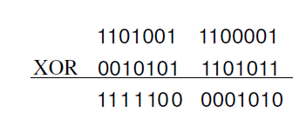
Stream Ciphers XOR
If Values are:
Alike 0
Different 1

Slide 24
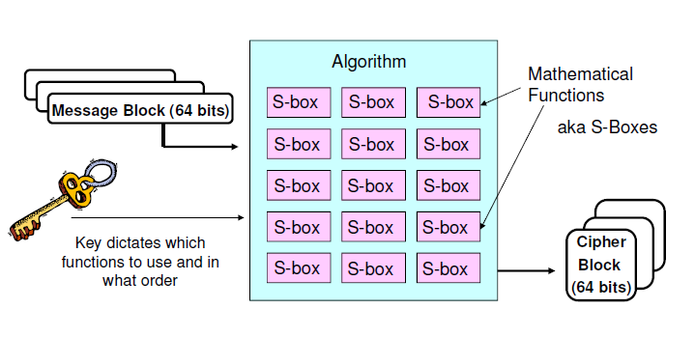
Block Ciphers

Slide 25
Common Symmetric Algorithms
Blowfish
IDEA
CAST
MARS
Skipjack
DES
3DES
AES
RC-4
RC-5
Two Fish

Slide 26
Asymmetric Cryptography

Slide 27
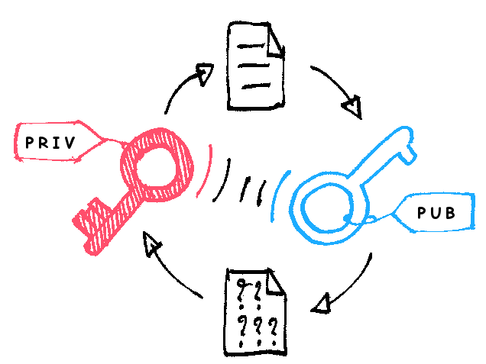
Asymmetric Cryptography
Every user has a key pair.
Public key is made available to anyone who requests it
Private key is only available to that user and must not be disclosed or shared
The keys are mathematically related so that anything encrypted with one key can only be decrypted by the other.

Slide 28
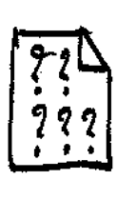
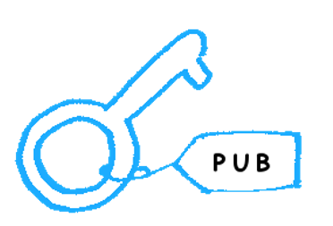
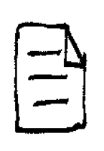

Privacy through Asymmetric Cryptography
Receiver’s
Sender encrypts message with receiver’s
Public Key
EncryptedMessage
Receiver decrypts message with receiver’s
Private Key
Receiver’s
Decrypted Message

Slide 29
Authenticity through Asymmetric Cryptography
Sender encrypts something small and meaningless (timestamp) to an attacker with Sender’s Private Key
Sender’s Private
Timestamp, (not message)
Receiver decrypts timestamp with Sender’s
Public Key, proving it had to have been encrypted by Sender’s private key
Sender’s Public
Timestamp, (not message)
Being able to decrypt the timestamp with Sender’s public key PROVES it was encrypted with Sender’s private key
Notes:
What are we trying to prove? The AUTENTICITY of the SENDER. What does the sender have that no one else does? Sender’s private key. Why must what’s encrypted be meaningless to an attacker? Because anyone with the sender’s public key can decrypt it. Remember, this is not about privacy. The sender just needs something to encrypt with its private key. If the Sender’s public key can decrypt, it CAN ONLY have been encrypted with the sender’s private key, which proves it came from the sender.

Slide 30
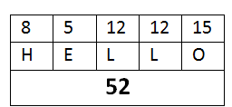

Hashing (Checksums/Message Digests)
Fixed length digital representation of the contents of the file
If the file changes, the hash will change
One-way math
When two different documents produce the same hash it is called a collision
A birthday attack is an attempt to cause collisions. It is based on the idea that it is easier to find two hashes that happen to match than to produce a specific hash.
If an attacker has the ability to change the message, why wouldn’t they change the hash also? THEY WOULD. So……remember this for later.
MD-5 128-bit
SHA-1 160-bit
SHA-2 256, 384, 512, etc.
HAVAL, TIGER, RIPEMD are lesser known hashing algorithms

Slide 31
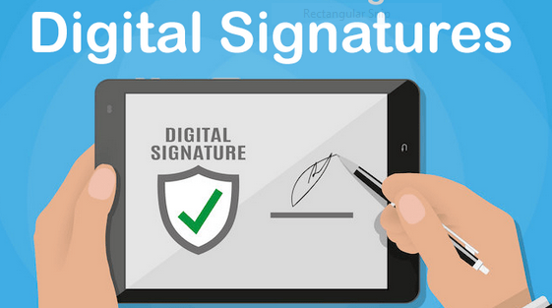
Non-Repudiation Through Digital Signatures
Sender hashes document for integrity
Hash is encrypted with SENDER’S PRIVATE Key
Message is sent to user, who tries to decrypt the hash with the SENDER’S PUBLIC KEY. Only something that was encrypted by the sender’s private key can be decrypted with the sender’s public. This proves the authenticity of the sender
Sender encrypts the hash with Sender’s Private Key

Slide 32
Asymmetric P.A.I.N
Privacy: Receiver’s Public Key
Authenticity: Sender’s Private Key
Integrity: Hash/checksum/CRC—neither symmetric nor asymmetric
Non-Repudiation: Hash encrypted by sender’s private key

Slide 33
Common Asymmetric Algorithms
DSA
RSA
ECC (Elliptical Curve Cryptography)
El Gamal
Diffie Hellman
Knapsack

Slide 34

The Buddy System for Asymmetric Algorithms
RSA and DSA
ECC and El Gamal)
DH (Diffie Hellman) and Knapsack

Slide 35
RSA
Named for Rivest, Shamir, and Adleman, the creator
Currently the standard for Digital Signatures
Uses the idea that there is no efficient way to factor the product of large prime numbers
The math used for RSA is sometimes referred to as a trap-door function
****Factorization*****
Notes:
Y

Slide 36
Diffie-Hellman
The first asymmetric algorithm
Secure key-agreement without pre-shared secrets
Based on discrete logarithms in a finite field

Slide 37
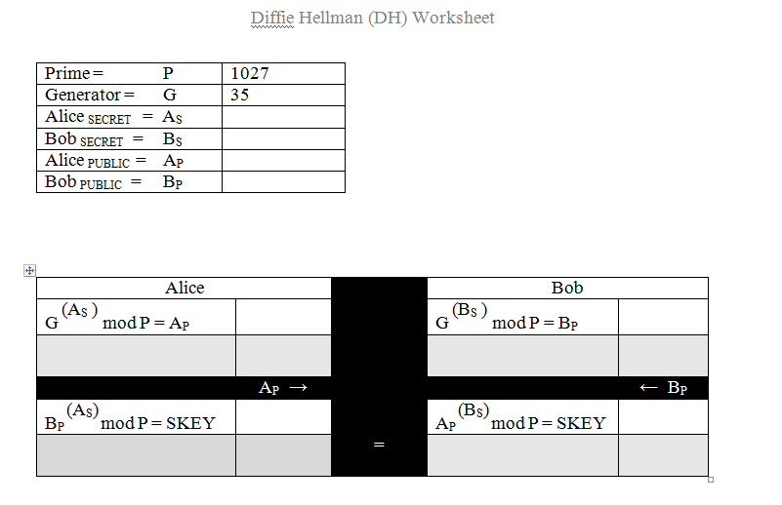
Diffie Hellman Key Agreement

Slide 38
ECC (Elliptical Curve Cryptography)
Based upon plotting points along a curve
Very efficient, but only applicable for key agreement, digital signatures, pseudo-random generators and other tasks
Frequently used for handheld devices due to their limited processing capability

Slide 39
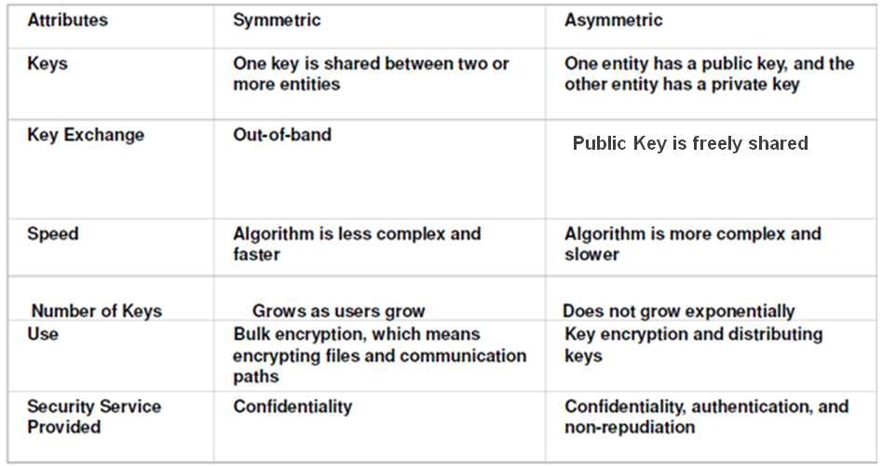
Summary of Symmetric vs. Asymmetric

Slide 40

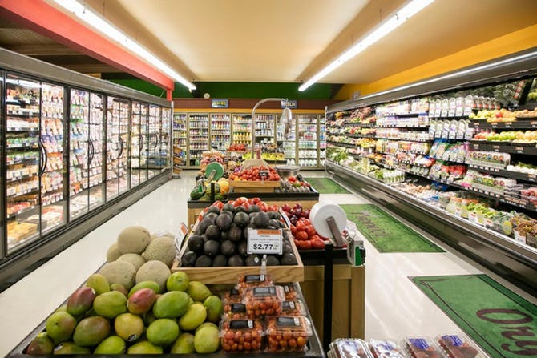
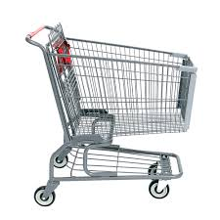
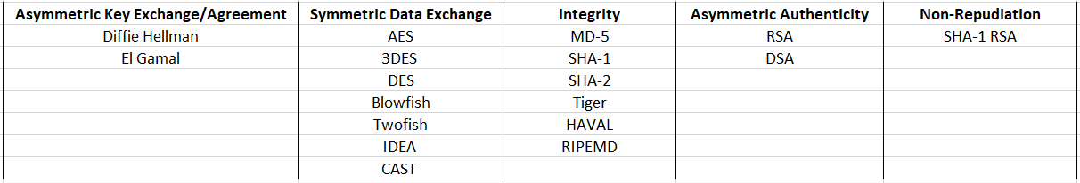
CRYPTO-MART

Slide 41
Hybrid Cryptography

Slide 42
Hybrid Cryptography
What We’d Like to Achieve
Privacy
Authenticity
Integrity
Non-Repudiation
SPEED
Our Problem: Neither Symmetric nor Asymmetric can provide ALL these services

Slide 43
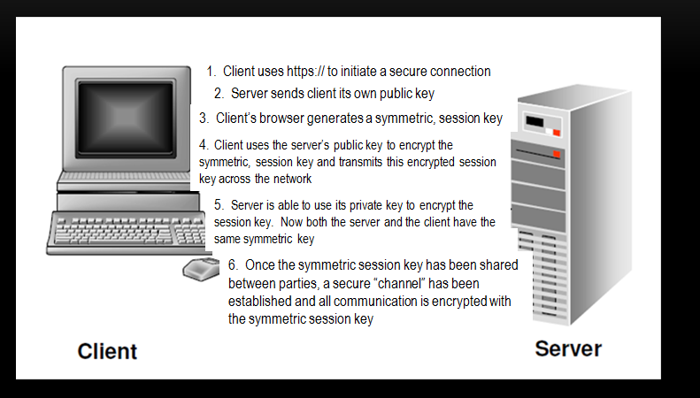
SSL/TLS Hybrid Cryptography
(8675309)
(8675309)

Slide 44
SSL/TLS Hybrid Cryptography
Client initiates a secure connection
Server responds by sending it’s public key to the client
The client then generates a symmetric session key.
Client encrypts uses the server’s public key to encrypt the session key.
Client sends the session key (encrypted with the server’s public key) to the server
Server uses it’s private key to decrypt the session key
Now that a symmetric session key has been distributed, both parties have a secure channel across which to communicate.

Slide 45
Public Key Infrastructure

Slide 46

Sounds Good, but….
How does the server get a key pair?
What happens if keys are compromised?
How do we know we have compatible software to exchange keys?
Do keys ever expire?
How would we renew them?
Stay tuned to the answers to these and many more questions…

Slide 47
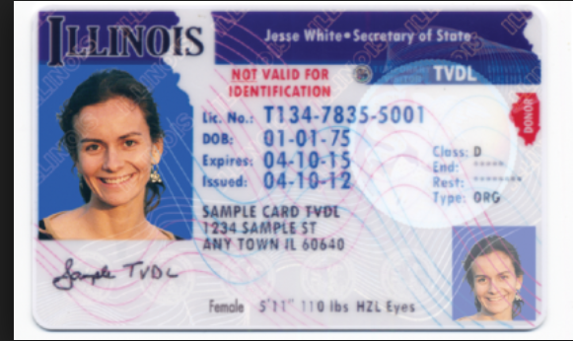
How Do we Prove our Identity?
Name?
Expiration Date
Class?
Serial Number?
Is it standardized?
Is it issued by a trusted authority?

Slide 48
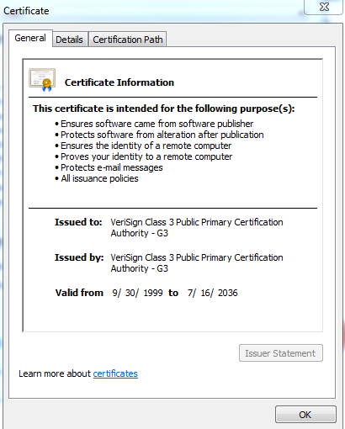
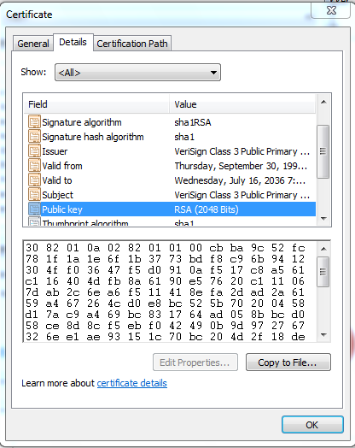
Certificates
X.509 v.4 standard
Provides authenticity of a server’s public key
Necessary to avoid MITM attacks with server’s using SSL or TLS
Digitally signed by Certificate Authority

Slide 49
PKI (Public Key Infrastructure)
Certificate Authority (CA)
Registration Authority (RA)
Certificate Repository
Certificate Revocation List

Slide 50
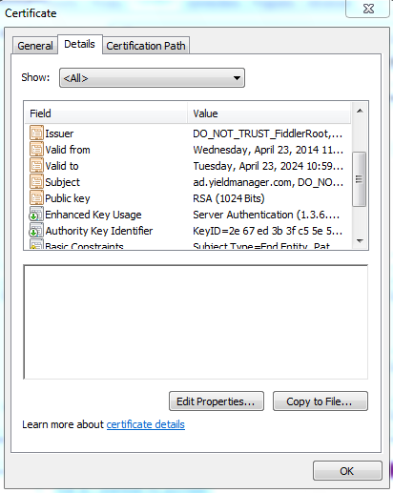
Certificate Contents

Slide 51
Certificate Revocation
CRL: CA publishes CRL. Client is responsible for downloading to see if a certificate has been revoked.
OCSP (Online Certificate Status Protocol) Streamlines the process of verifying whether or not a certificate has been revoked.

Slide 52
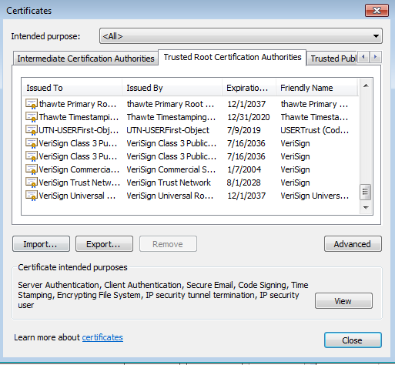
Trusted Certificate Authorities

Slide 53
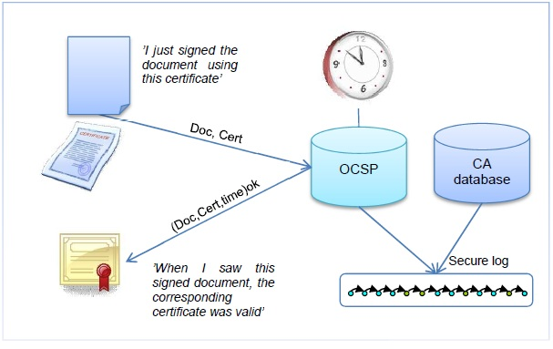
OCSP (Online Certificate Status Protocol)

Slide 54
MACs (Message Authentication Codes)

Slide 55
Integrity
Data could be modified
Accidentally through corruption
Intentionally through malicious alteration
Hash: only good for accidental modification
MAC: Provides reasonable authenticity and integrity not strong enough to be non-repudiation (because it uses a symmetric key)
Digital Signatures: Can detect both malicious and accidental modification, but requires an overhead. Provides true non-repudiation

Slide 56
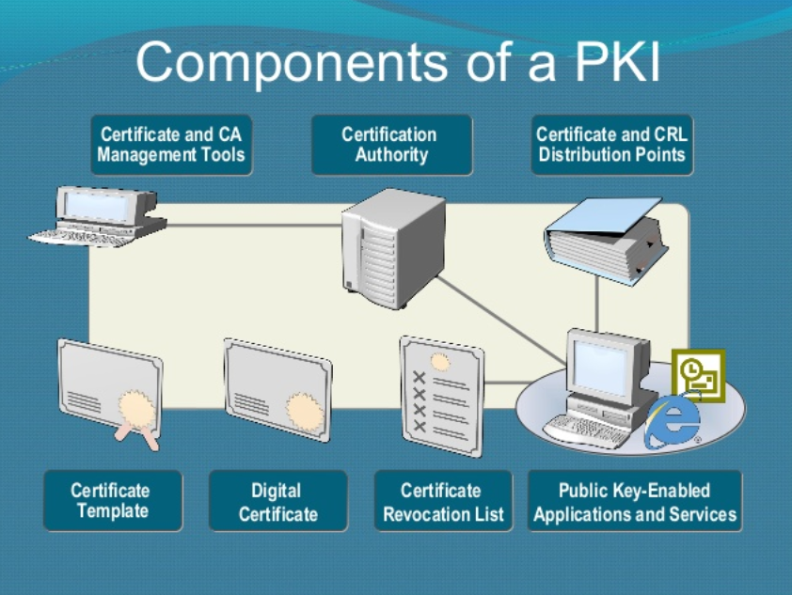
Quick Integrity Review
Hashing is only good for accidental modification/corruption, because a malicious attacker would simply modify the hash to evade detection
Digital Signatures use the sender’s private key + a hash to guarantee the integrity AND the origin of a message…but it requires lots of OVERHEAD of a Public Key Infrastructure

Slide 57
MAC (Message Authentication Code)
Message + Symmetric Number +Hashing algorithm
= HMAC
Integrity and (reasonable) authenticity
A MAC does not provide true authenticity (symmetric)

Slide 58
Review: Module 3 Security Engineering and Architecure Part 1: Cryptography
Cryptography Through History
Cryptography Basics
Symmetric Cryptography
Asymmetric Cryptography
Hybrid Cryptography
Public Key Infrastructure
MACs
IPSec
Email Cryptosystems
Attacks on Cryptography

